Slide 1
RISK ASSESSMENTS

Slide 2
WHAT IS A RISK ASSESSMENT?
It is a way of determining risks and dangers in work places
Risk assessments include analysing the possible hazard that could occur within a workplace and finding a solution in a safe manner. This avoiding injury to an individuals and damage to property
If the hazard cannot be avoid in a safe way, then the risk assessment will say that the activity shouldn’t be carried out

Slide 3
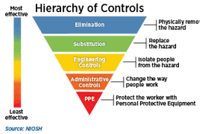
Hierarchy of controls

Slide 4
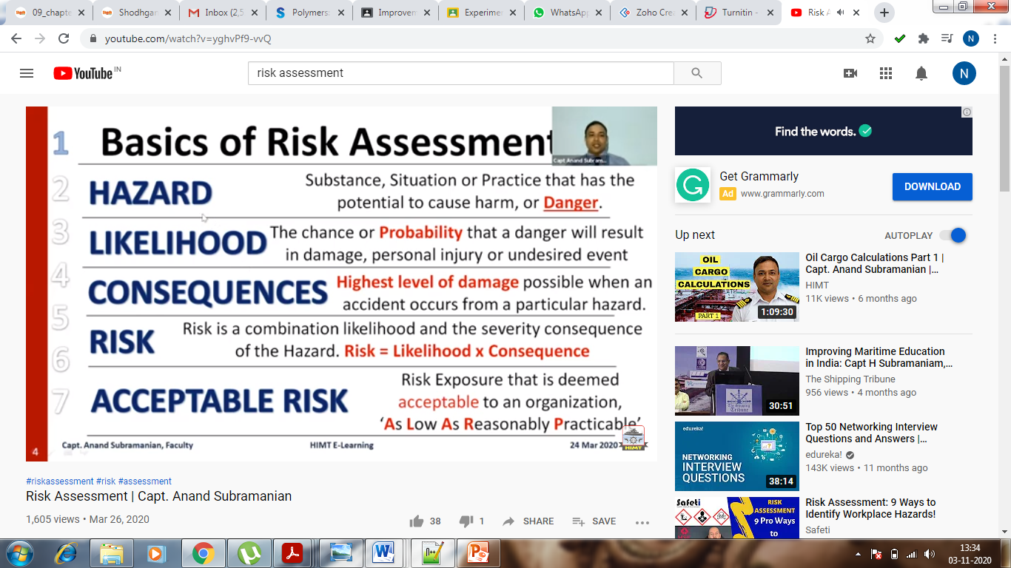
Basics of Risk Assessment

Slide 5
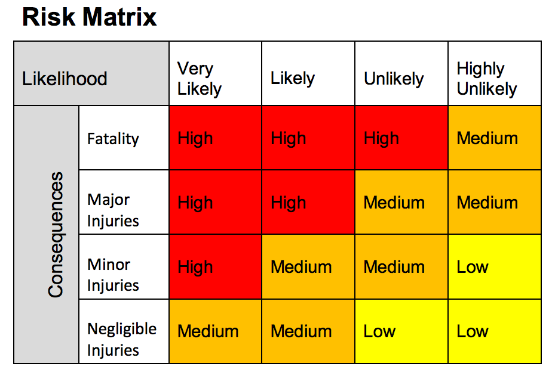
Risk Matrix
A risk matrix is often used during a risk assessment to measure the level of risk by considering the consequence/ severity and likelihood of injury to a worker after being exposed to a hazard.
The two measures can then help determine the overall risk rating of the hazard. Two key questions to ask when using a risk matrix should be:
Consequences: How bad would the most severe injury be if exposed to the hazard?
Likelihood: How likely is the person to be injured if exposed to the hazard?

Slide 6
WHY DO WE HAVE RISK ASSESSMENTS?
They are needed to assess any danger that people could be put in when they are in the workplace
Risk assessments are needed so that the risks of danger happening within the workplace is reduced and eliminated.
They are in order to protect people within the workplace, not only the person carrying out the practical's but others around
They help to set out guidelines to what you should and shouldn’t do within a workplace for safety

Slide 7
WHAT SHOULD A RISK ASSESSMENT COVER?
A risk assessment must include the possible dangers that could occur in the workplace
The risk assessment should include guidelines for protecting people.

Slide 8
HOW DOES A RISK ASSESSMENT WORK?
Each workplace would have their own forms of risk assessments so there isn’t set guidelines on how the risk assessment should be carried out.
Before a risk assessment is produce the difference between a risk and a hazard must be known
Hazard: Anything that can cause
harm, electricity, hazardous substances and noise are potential hazards.
Risks: “The likelihood that damage, loss or injury will be caused by a hazard and how severe the outcome may be.”

Slide 9
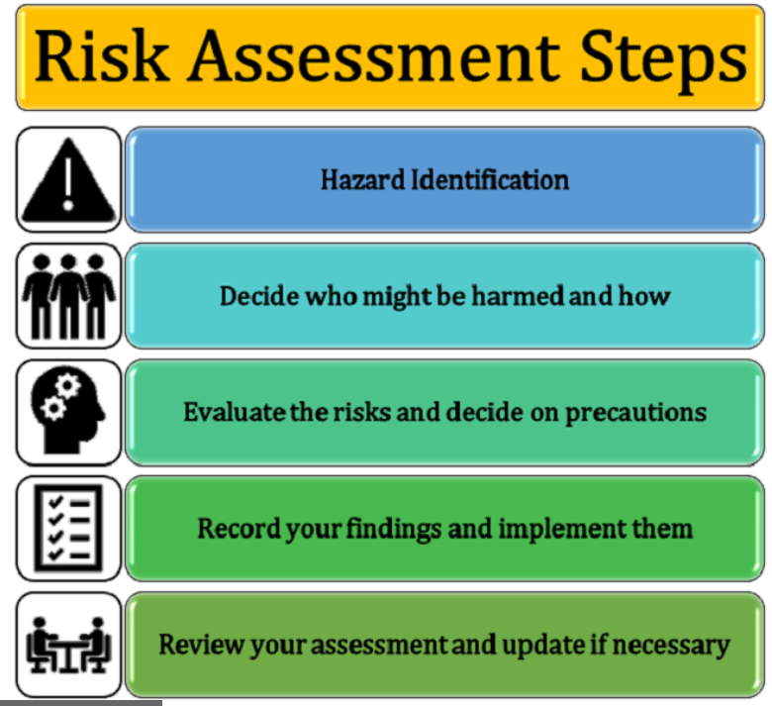
HOW DOES A RISK ASSESSMENT WORK?
When carrying out a risk assessment there are 5 recommended guidelines.
Identifying the hazard:
Decide who might be harmed and how
Evaluate the risks and decide on the precautions
Record your findings and put them into place
Review you risk assessments and make amendments if needed
A risk assessment should be carried out yearly.

Slide 10
Basic steps followed in process are identification of hazards and assessment and control of risk
RISK ASSESSMENT
CLASSIFYING WORK ACTIVITIES
IDENTIFICATION OF HAZARDS
EVALUATION OF HAZARDS
CONTROL OF HAZARDS
REVIEWING OF ADEQUACY OF ACTION PLAN
PREPARATION OF RISK CONTROL ACTION PLAN
CARRY OUT PROCESS, IF RISK IS TOLERABLE OR MODIFY PROCESS, CONFIRMING SAFETY

Slide 11
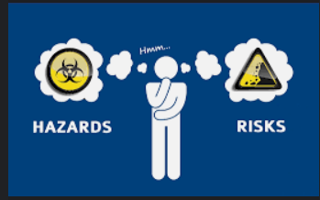
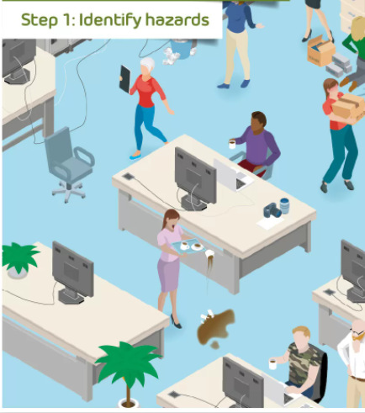
STEP ONE: IDENTIFYING THE HAZARDS
Within the workplace there would be many possible hazards. So these would need to be quickly identified before they can cause harm to anyone.
Firstly you would need to know what can be classed as hazardous before identifying hazards
Look around for any chemicals that may cause harm and any equipment that may be faulty or be in a place where it could get in someone's way.
You would also have to think about any long term hazards there may be.

Slide 12
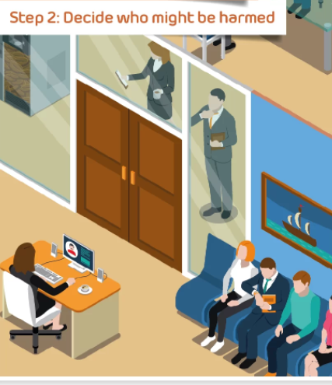
STEP 2: DECIDE WHO MIGHT BE HARMED AND HOW
Think about the possible health risk or injury that could be caused to an individual.
Take into account any workers that may have special health and work requirements
Think about new workers that work within the workplace as they may not know the way the equipment works.
It needs to be taken into account about how the workplace activities can affect the public

Slide 13

STEP 3: EVALUATE THE RISKS AND DECIDE ON THE
PRECAUTIONS
After spotting the hazard decide on the actions that would need to be taken
When this has been done you would need to do anything reasonable practical that would eliminate the risks of the hazard occurring
If there is no way of eliminating the hazard happening then a precaution would need to be taken to control the risk to the best ability i.e. try and carry out a less risky activities

Slide 14

STEP 4: RECORD YOUR FINDING AND PUT THEM INTO
PLACE
Once the results are recovered for the risk assessment then all staff within the industry be informed
When writing out a risk assessment results it needs to be kept simple and understandable
A risk assessment do not need to be perfect but it needs to show that an inspection has been carried out correctly and that precautions are reasonable leaving the risk to a minimum

Slide 15

STEP 5: REVIEW YOUR RISK ASSESSMENT AND MAKE
AMENDMENTS IF NECESSARY
Make sure that the risk assessment is correct, and that all hazards have been covered and included. Make sure that the people are safe to work within the workplace
If hazards occur later on (after a risk assessment has been conducted) then changes will need to be made to that risk assessment.
A risk assessment should be carried out yearly to minimise the risks within an industry

Slide 16
Techniques for evaluating hazards
Hazard and Operability study(HAZOP)
Accident consequence analysis
Event Tree Analysis
Fault Tree Analysis
Failure modes, effects and critical analysis

Slide 17
What is the second stage of quantitative risk assessment?
Hazard identification
Exposure assessment
Toxicity assessment
Risk characterization

Slide 18
Why does site history have to be considered for hazard identification?
To estimate the risk
To calculate carcinogenic exposure
To know the probable source and causes of contamination on site
For determination of remedial actions

Slide 19
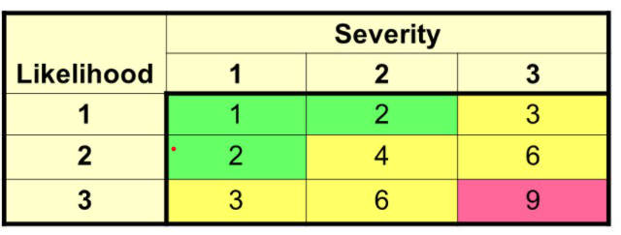
From this risk matrix, which colour code indicates risk rating is low?
Green
Yellow
Pink
None of the above

